Slide 1
CS310 Operating Systems Lecture 27 : Thread Scheduling, Linux Scheduling
Ravi Mittal
IIT Goa

Slide 2
Acknowledgements !
Contents of this class presentation has been taken from various sources. Thanks are due to the original content creators:
Book: Linux System Programming, Robert Love
CS162, Operating System and Systems Programming, University of California, Berkeley
Book: Modern Operating System, Andrew Tanenbaum

Slide 3
Reading
Book: Linux Kernel Development, Robert Love
Chapter 4 Process Scheduling
Book: Advanced Unix Programming, by Mark J Rochkind

Slide 4
Previous Classes

Slide 5
First-Come, First-Served (FCFS) Scheduling
First-Come, First-Served (FCFS)
Also First In First Out (FIFO) or Run until done
In early systems, FCFS meant one program scheduled until done (including I/O)
Now, means keep CPU until thread blocks
Simple Algorithm, Easy to implement (+)
FCFS Scheme: Potentially bad for short jobs!
Depends on submit order
If you are first in line at supermarket with milk, you don’t care who is behind you, on the other hand…
Convoy effect: short process stuck behind long process (-)
Ref: CS162 © UCB Fall 2020

Slide 6
Shortest Job First (SJF)
Non-preemptive
Run whatever job has least amount of computation to do
Provably optimal
Need to know run times in advance
Kubiatowicz CS162 © UCB Fall 2020

Slide 7
Shortest Remaining Time First (SRTF)
Preemptive version of SJF
If job arrives and has a shorter time to completion than the remaining time on the current job, immediately preempt CPU
Sometimes called Shortest Remaining Time to Completion First (SRTCF)
Both SJF and SRTF:
These can be applied to whole program or current CPU burst
Idea is to get short jobs out of the system
Big effect on short jobs, only small effect on long ones
Result is better average response time
Kubiatowicz CS162 © UCB Fall 2020

Slide 8
Round Robin (RR) Scheduling
Uses Preemption!
Each process gets a small unit of CPU time (time quantum), usually 10-100 milliseconds
After quantum expires, the process is preempted and added to the end of the ready queue
n processes in ready queue and time quantum is q
Each process gets 1/n of the CPU time
In chunks of at most q time units
No process waits more than (n-1)q time units
Ref: CS162 © UCB Fall 2020

Slide 9
Multilevel Queue Scheduling – Strict Priority
Priority 3
Job 1
Job 2
Job 3
Priority 2
Job 4
Priority 1
Priority 0
Job 5
Job 6
Job 7
Execution Plan
Always execute highest-priority runnable jobs to completion
Each queue can be processed in RR with some time-quantum
A priority is assigned statically to each process, and a process remains in the same queue for the duration of the run time
Problems
Starvation
Lower priority jobs don’t get to run because higher priority jobs
Deadlock: Priority Inversion
Happens when low priority task holds a lock needed by high-priority task
Ref: CS162 © UCB Fall 2020

Slide 10
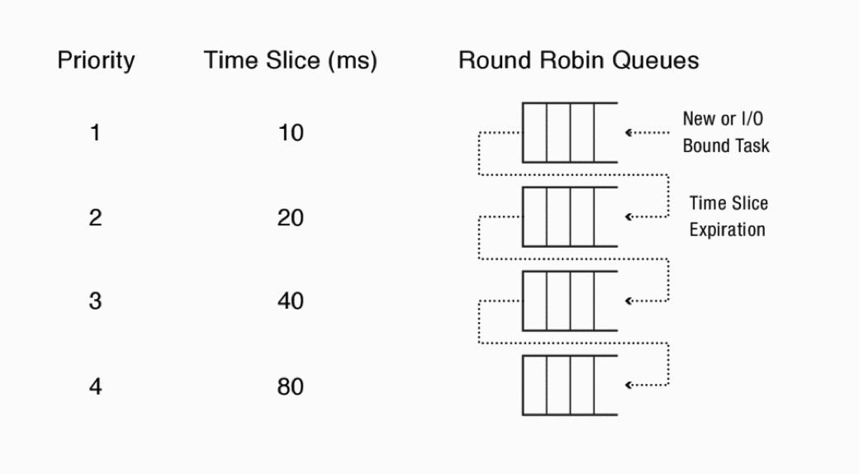
Example of Multilevel Feedback Queue
Ref: Book: Anderson and Dahlin

Slide 11
Lottery Scheduling
Proportional share scheduling
Give each job some number of lottery tickets
On each time slice, randomly pick a winning ticket
On average, CPU time is proportional to number of tickets given to each job
How to assign tickets? Users can define policy
To approximate SRTF, short running jobs get more, long running jobs get fewer
To avoid starvation, every job gets at least one ticket (everyone makes progress)
Advantage over strict priority scheduling: behaves gracefully as load changes
Adding or deleting a job affects all jobs proportionally, independent of how many tickets each job possesses
Use Randomness
Requires a good random number generator
Ref: CS162 © UCB Fall 2020

Slide 12
Scheduling Summary
FCFS is simple and it minimizes overhead
If tasks are variable in size, FCFS can have very poor average response time
FCFS suffers from convoy effect
SJF is optimal in terms of average response time
If tasks are variable in size, Round Robin approximates SJF
If tasks are equal in size, Round Robin will have very poor average response time
Round Robin avoid starvation
MFQ scheduler can achieve a balance between responsiveness, low overhad and fairness

Slide 13
Thread - Scheduling

Slide 14
So, Does the OS Schedule Processes or Threads?
Switching threads vs. switching processes incurs different costs:
Switch threads: Save/restore registers
Switch processes: Change active address space too!
Expensive
Disrupts caching
A system have have many processes and many threads running
Recall User level threads vs Kernel level threads
Scheduling for both differs
Book: Tenenbaum’s Book on Modern OS

Slide 15
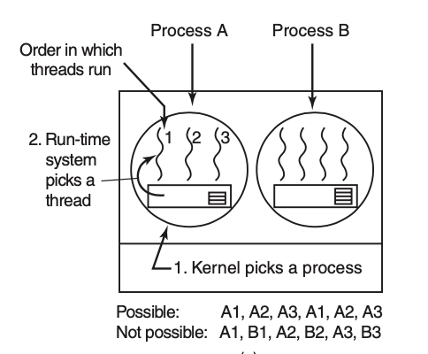
User level thread Scheduling
Kernel is not aware of existence of threads
Kernel picks up a process, say A, and giving it a control for the quantum
Runtime system (Thread scheduler) inside A decides which thread to run, say A1
As there are no clock interrupts used within Runtime System, A1 will continue to run unless it has do to I/O or process scheduler context switches it
When A is resumed back, A1 again starts running
If A1 finishes within the quantum, runtime scheduler will schedule A2 ..and so on
Runtime scheduler can run any scheduling algorithm: example: RR
Book: Tenenbaum’s Book on Modern OS

Slide 16
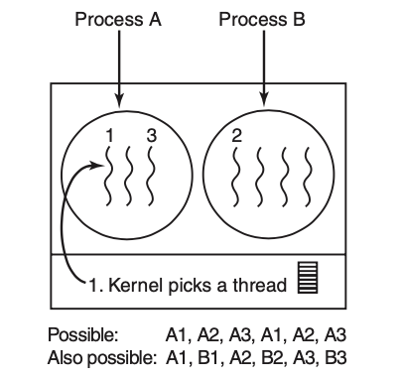
Kernel level thread Scheduling
Kernel picks up a particular thread to run
It doesn’t take into account which process the thread belongs to
However it can take into account if it wants to
Doing thread scheduling at Kernel level requires full context switch
Changing memory map
Cache data management
Slower than that in User level switching
If a thread blocks on I/O, entire process is not blocked
Kernel can switch to another thread in the same process
Runtime scheduler can run any scheduling algorithm: example: RR
Book: Tenenbaum’s Book on Modern OS

Slide 17
Linux – Completely Fair Scheduler (CFS)

Slide 18
Linux Scheduler Overview
Scheduling policy attempts to satisfy conflicting goals
Fast process response time
Maximal system utilization (throughput)
Aims to provide good interactive responses
→ favors I/O bound processes over processor bound processes
Done in creative manner – doesn’t neglect processor-bound processes
Reasonably good for Real-time applications
So, there must be something to handle real-time processes
Priority based Scheduling
So, there must be some way to define priority of a process
Preemptive Scheduling
Thread based Scheduling – Linux treats a process (without threads inside) as a single thread – Kernel level threads
Two states that are of interest in scheduling: blocked and runnable
Book: Linux Kernel Development : Robert Love

Slide 19
Priority Based Scheduling
CFS was introduced in Linux 2.6.23 in 2207
For Normal processes .. Named as SCHED_NORMAL
Can be configured for batch workloads: SCHED_BATCH
Rank processes based on their worth and need for processor time
User and the system can set a process’s priority
Real-Time processes have higher priorities than those of all normal processes
The Linux kernel implements two separate priority ranges
Nice value
Real time priority
Book: Linux Kernel Development : Robert Love

Slide 20
Real Time Priority
Range from 0 to 99, inclusive
Opposite from nice values, higher real-time priority values correspond to a greater priority
All real-time processes are at a higher priority than normal processes
The real-time priority and nice value are in disjoint value spaces
Book: Linux Kernel Development : Robert Love
Notes:
ps -eo state,uid,pid,ppid,rtprio,time,comm

Slide 21
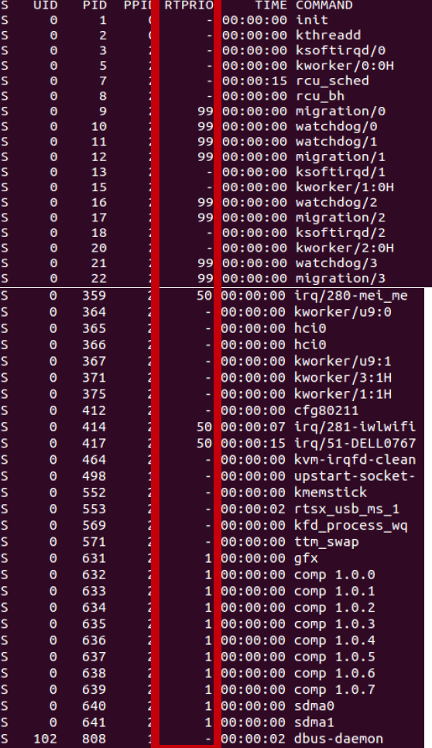
ps -eo state,uid,pid,ppid,rtprio,time,comm

Slide 22
Nice Value
A number from –20 to +19 with a default of 0
Larger nice values correspond to a lower priority
you are being “nice” to the other processes on the system
Processes with a lower nice value (higher priority) receive a larger proportion of the system’s processor compared to processes with a higher nice value (lower priority)
Nice values are the standard priority range used in all Unix systems
Different Unix systems apply them in different way based on the individual scheduling algorithm
Mac OS X, the nice value is a control over the absolute timeslice allotted to a process;
In Linux, it is a control over the proportion of timeslice
Book: Linux Kernel Development : Robert Love
Notes:
Nice value: command ps -el

Slide 23
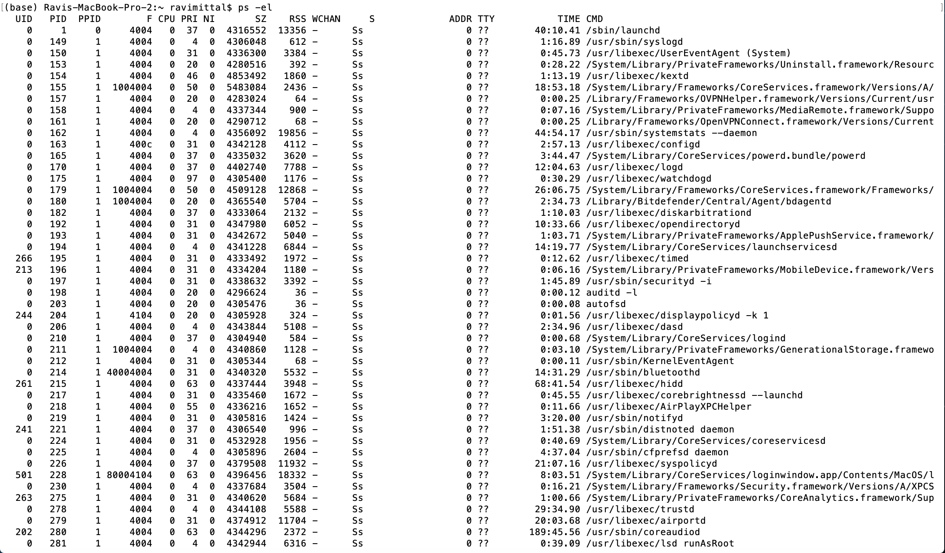
ps -el

Slide 24
CFS
No fixed timeslices
This is a major change from other OSs – where time given to each processor remains fixed
No explicit priorities
Does this mean priority of a process/thread changes over time?
Amount of time for a given task is computed dynamically
As scheduling context changes
Book: Linux Kernel Development : Robert Love

Slide 25
CFS - Algorithm
CFS is designed to approximate perfect multitasking
Imagine as processor P, which is idealized in that it can executed multiple tasks simultaneously
If there are two tasks, both can run a the same time ; each receiving 50% of processing power
CFS scheduler has a target latency
Idealized as very small duration – such that every runnable task gets at least one turn
Call it target latency : say 20 ms
If there are N tasks, each get 1/N slice of target latency
Example: If N = 4 each task get 5 ms
Note that 1/N Slice : is not fixed as it depends on N
N keeps changing
Book: Linux Kernel Development : Robert Love

Slide 26
CFS - Algorithm
Each of these tasks (N) will contend for processor
Now, traditional Nice value is used to weight the 1/N slice
Low priority nice value : only a fraction of the 1/N slice is given to the task
High priority nice value: proportionately greater fraction of the 1/N slice is given to a task
Nice values only modify 1/N slice
To take care of overheads of switching, a minimum amount of time is fixed – where in a process must run before being preempted - called minimum granularity
Assume 4 ms
If more number of processes are contending (say 20 processes), 1/N slice is much smaller than minimum granularity
No fairness
Book: Linux Kernel Development : Robert Love

Slide 27
How does preemption occur?
A task is preempted when it’s period : weighted 1/N slice completes
Which task is chosen to run now?
Runnable task, say T2, which has the lowest virtual runtime (vruntime) among the tasks contending for the processor
vruntime ( in nanosecond): records how long a task has run on the process
Scheduler tracks the vruntime for all tasks
Runnable and blocked
Lower a task’s vruntime, more deserving the task is for the time on the processor
vruntime = actual runtime normalized by the number of runnable processes
Book: Linux Kernel Development : Robert Love

Slide 28
Rescheduling
Rescheduling is required when the number of tasks , N, becomes such that
N > Target Latency / Minimum Granularity
Now scheduler changes the Target latency to
N * minimum latency
Book: Linux Kernel Development : Robert Love

Slide 29
Summary: Choosing the Right Scheduler
If You Care About: | Then Choose:
CPU Throughput | FCFS
Average Response Time | SRTF Approximation
I/O Throughput | SRTF Approximation
Fairness (CPU Time) | Linux CFS
Fairness (Wait Time to Get CPU) | Round Robin
Meeting Deadlines | Earliest Deadline First (EDF)
Favoring Important Tasks | Priority

Slide 30
Backup Slides

Slide 31
Choosing Time-slice
The scheduler policy must dictate a default timeslice
Not easy to choose this number
Too long timeslice → poor interactive performance
Too short timeslice → Overhead of switching processes
I/O bound processes don’t need longer timeslice
Linux’s CFS scheduler, however, does not directly assign timeslices to processes
CFS assigns processes a proportion of the processor
the amount of processor time that a process receives is a function of the load of the system
This assigned proportion is further affected by each process’s nice value
Acts as a weight, changing the proportion of the processor time each process receives

Slide 32
Time Slice
The rule of thumb adopted by Linux is: choose a duration as long as possible, while keeping good system response time
Which process to run ?
Decision also depends on how much proportion of the processor the process has consumed
If it has consumed small proportion of the processor, it is run immediately

